Slide 1

Industrial 5G
5G HUB
Vaasa

Slide 2




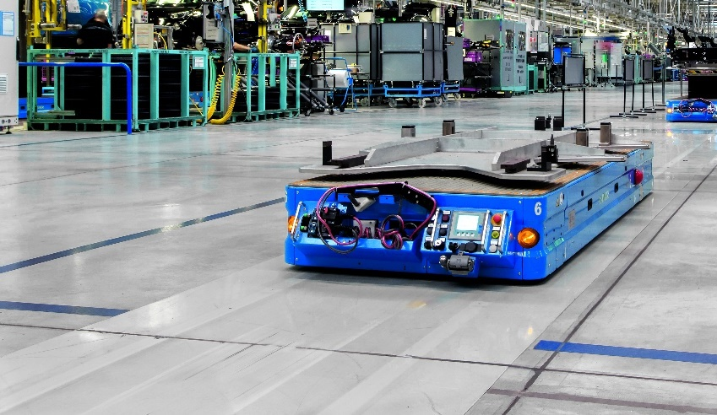

Potential industrial applications with Industrial 5G
Mobile Equipment
Remote Access
Backhaul
Autonomous Machines
Autonomous Logistics
Edge

Slide 3
Classification of applications according to network requirements Factory and Process Automation
Augmented Reality
Data Rate
Remote Access & Maintenance
Human Machine Interface (HMI)
Automated Guided Vehicles (AGVs)
Closed Loop Control (Process Automation)
Number of devices
5G
Latency/ Reliability
Mobile Robots
Remote Control
Industrial Safety
Massive Wireless Sensor Networks
Closed Loop Control (Factory Automation)

Slide 4
Why can we only start with Release 16 in Industry?
 | Release 15 Available: Dec. 2018 | Release 16 Available: July 2020 | Release 17 Available: June 2022 | Release 18 Planned: Q2/2024
Data rate / Area traffic capacity (20 Gbps) | Complete | Complete | Complete | Complete
Spectrum efficiency (3 x 4G) | Complete | Complete | Complete | Complete
Network Energy efficiency (100x 4G) | Complete | Complete | Complete | Complete
Connection density (1,000,000 / km²) | Partially | Partially | Complete | Complete
Latency (<10 ms) | None | Partially | Complete | Complete
Reliability (99.999% under 10 ms) | None | Partially | Complete | Complete
Mobility (handover/ roaming with 500 km/h) | Complete | Complete | Complete | Complete
Localization (Phase 1: 1 meter accuracy) | None | Partially | Partially | Complete
Non-public networks (Private Networks) | None | Partially | Complete | Complete
Industrial IoT (TSN Support) | None | Partially | Partially | Complete
Network slicing (Multiple networks on shared network) | Complete | Complete | Complete (+ more) | Complete (+ more)
SideLink (Direct Communication between end-devices) | None | Partially | Partially | Complete
eMBB
eMBB
eMBB
eMBB
mMTC
5G
URLLC
mMTC
5G
URLLC
mMTC
5G
URLLC
mMTC
5G
URLLC
Advanced

Slide 5
Which 5G infrastructure is right for your Industrial Automation?
Flexibility: Very limited, depends on provider
Privacy: Insufficient w/o additional precaution
QoS: Not guaranteed
Network: Depends on implementation of provider
Flexibility: Limited, depends on provider
Privacy: UEs are visible outside
QoS: Best effort
Network: This scenario is one possible way of slicing, depends on provider
Flexibility: Unlimited
Privacy: Optimal
QoS: Optimal
Network: This scenario is only possible with access to spectrum
Public
Control plane
User plane
Control plane
Industrial 5G
Location 1
Location 2
Control plane
User plane
User plane
Private
Used frequency: 3,4 … 3,7 GHz (Public)
Used frequency: 3,4 … 3,7 GHz (Public)
Used frequency: 3,7 … 3,8 GHz (Private)²
¹ Depends on the implementation of the provider, most likely variants are shown
² Based on German spectrum model

Slide 6
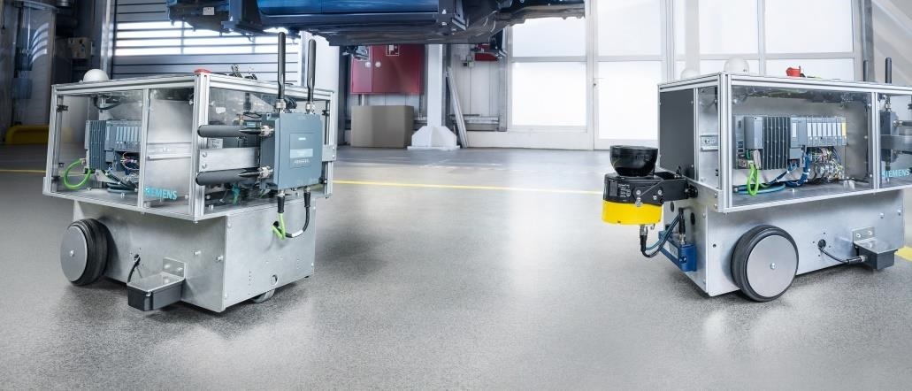
Siemens Industrial 5G End Devices based on Release 15 SCALANCE MUM856-1 direct mounted on a SIMOVE AGV
SCALANCE MUM856-1
5G User Equipment in the form of an Industrial Router, IP65, to direct mount on for example AGVs. Supporting Rel. 15 of the 5G standard.

Slide 7
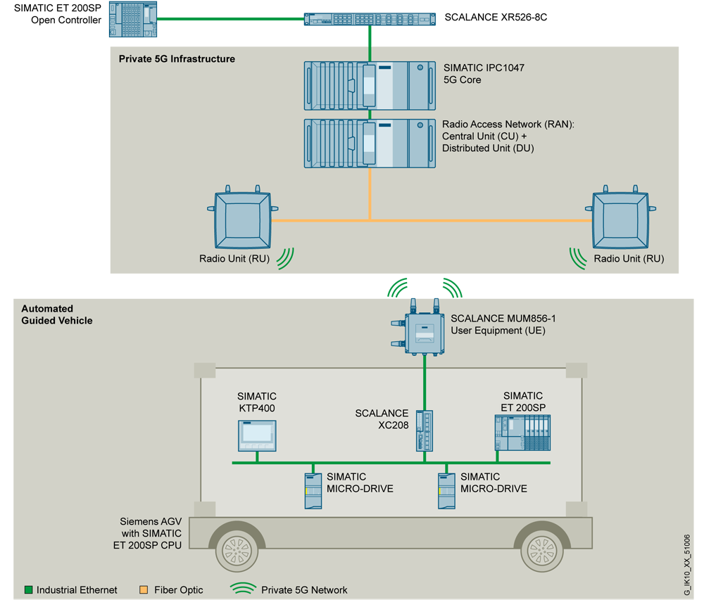
5G Use Cases Connection of automated guided vehicle system to a private 5G network
Task
Reliable connection of stationary and mobile participants to private industrial 5G networks Implementation using 5G release 15 onwards
Solution
SCALANCE MUM856-1 with its IP65 enclosure enables the connection of different participants to private 5G networks Rugged design enables the mounting outside of the control cabinet and on stationary and mobile participants in harsh industrial environments
Benefits
Benefitting from the advantages of 5G technology in private industrial networks Flexible utilization of a device for both public and private 5G networks – depending on configuration Compatible with private third-party 5G networks* (e.g., Nokia, Ericsson)
CPU
* Smooth integration in private third-party networks is not guaranteed; use in Nokia and Ericsson networks has been tested successfully
Please note that the SCALANCE MUM856-1 can be replaced by the SCALANCE MUM853-1 depending on the environmental and deployment circumstances

Slide 8
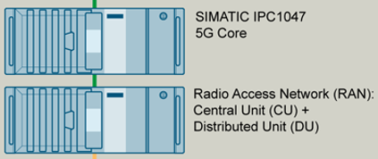



5G Use Cases Redundant connectivity to company infrastructure
Task
Redundancy mechanism to connect production cells to company infrastructure Implement security cell concept using IP segmentation and standard mechanisms Implementation using 5G release 15 onwards
Solution
SCALANCE MUM853-1 with its 4 RJ45 ports and 5G interface enables the connection to fixed WAN and 5G networks Using IP and interface tracking, automatic switchover takes over in case of path failure
Benefits
Redundant path without cabling IT/OT integration based on standard mechanisms Firewall and NAT integrated in 5G UE
DEFAULT ROUTE
BACKUP ROUTE
Production cell
MUM853-1
CPU

Slide 9

5G Use Cases Local area network connectivity over routing
Task
Connect segmented automation cells Enable LAN connectivity between members
Solution
SCALANCE MUM800 and SC600 devices create overlay network using VXLAN encapsulation No need to change IP subnets
Benefits
By means of VXLAN in SCALANCE products, PROFINET IO can be transferred over Layer 3 networks e.g. in private 5G networks Profinet name assignment on remote site via TIA Portal is possible VXLAN traffic can be filtered with SC-600 Bridged Firewall
SC600
VXLAN encapsulation
Profinet
Please note that the SCALANCE MUM856-1 can be replaced by the SCALANCE MUM853-1 depending on the environmental and deployment circumstances

Slide 10
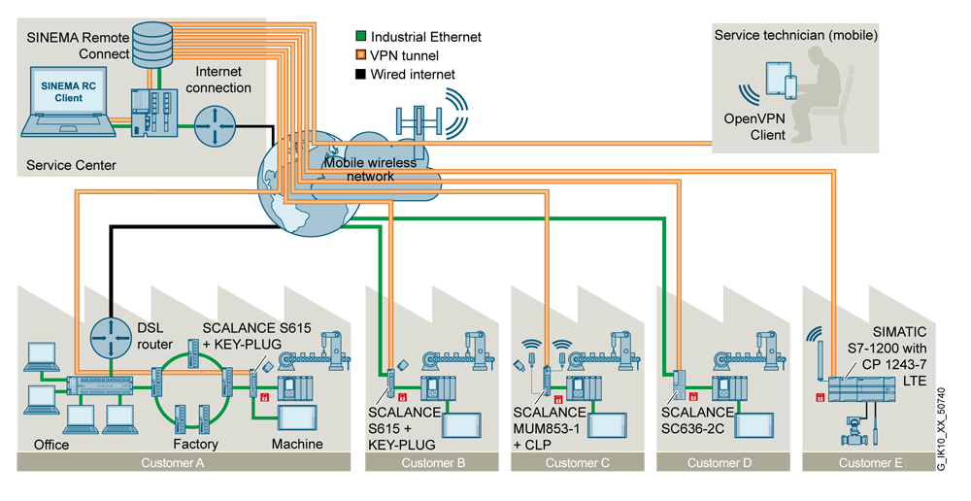
SCALANCE M with SINEMA Remote Connect Secure connection of remote machines via VPN
Task
Easy and secure remote maintenance of machinery and larger installations – also with the latest 5G mobile communications technology Connection of stationary and mobile participants over 5G to an existing SINEMA Remote Connect server
Solution
SCALANCE MUM856-1 with its IP65 enclosure enables the connection of stationary and mobile participants to public 5G networks and offers SINEMA Remote Connect support User-friendly setup of devices with routing/ NAT information in SINEMA Remote Connect Access to machinery/ installations is secured by security mechanisms (OpenVPN) and integrated stateful inspection firewall Benefits Realization of data-intensive applications with high bandwidth Can be used without specialized IT knowledge Transparent IP communication Prevention of manipulation and unauthorized access through secure data transmission and authentication Seamless technology – proven workflow is maintained Cost savings – same remote maintenance system in all networks Cell protection concept (defense in depth) also with 5G

Slide 11
Contact
Teemu Kumpulainen
Portfolio Consutant Professional
E-mail: teemu.Kumpulainen@siemens.com
LinkedIn: https://www.linkedin.com/in/teemu-kumpulainen-75406893/
Website: www.siemens.com/industrial-5g

Slide 12
Security information
Siemens provides products and solutions with industrial security functions that support the secure operation of plants, systems, machines and networks.
In order to protect plants, systems, machines and networks against cyber threats, it is necessary to implement – and continuously maintain – a holistic, state-of-the-art industrial security concept. Siemens’ products and solutions constitute one element of such a concept.
Customers are responsible for preventing unauthorized access to their plants, systems, machines and networks. Such systems, machines and components should only be connected to an enterprise network or the internet if and to the extent such a connection is necessary and only when appropriate security measures (e.g. firewalls and/or network segmentation) are in place.
For additional information on industrial security measures that may be implemented, please visit https://www.siemens.com/industrialsecurity.
Siemens’ products and solutions undergo continuous development to make them more secure. Siemens strongly recommends that product updates are applied as soon as they are available and that the latest product versions are used. Use of product versions that are no longer supported, and failure to apply the latest updates may increase customer’s exposure to cyber threats.
To stay informed about product updates, subscribe to the Siemens Industrial Security RSS Feed under https://www.siemens.com/industrialsecurity.

Slide 13
Disclaimer
© Siemens 2023
Subject to changes and errors. The information given in this document only contains general descriptions and/or performance features which may not always specifically reflect those described, or which may undergo modification in the course of further development of the products. The requested performance features are binding only when they are expressly agreed upon in the concluded contract.
All product designations may be trademarks or other rights of Siemens AG, its affiliated companies or other companies whose use by third parties for their own purposes could violate the rights of the respective owner.

