Slide 1

Industrial use cases of 5G
PROGRAM
12.00 | Opening of the seminar
12.10 | 5G and beyond
12.40 | Private 5G networks: The cornerstone to Business Adaptability in Industry 4.0
13.00 | Open source is enabling innovation in 5G and beyond
13.20 | Private 5G infrastructure
13.40 | 4G/5G from the lab to the field
14.00 | Coffee break
14.20 | Nokia veturi program and Industrial metaverse
14.40 | Site-to-site communications for messages used in Wide Area Protection
14:55 | Industrial 5G and connectivity use cases
15.10 | 5G HUB Vaasa laboratory and services
15.30 | Closing of the seminar
 | Laboratory visit & Buffet
Welcome! Tervetulua! Välkommen! The presentation will begin shortly
Event organized by:
- Vaasa University of Applied Sciences - University of Vaasa - Novia University of Applied Sciences
as part of the 5G HUB Vaasa project
https://5ghubvaasa.fi

Slide 2



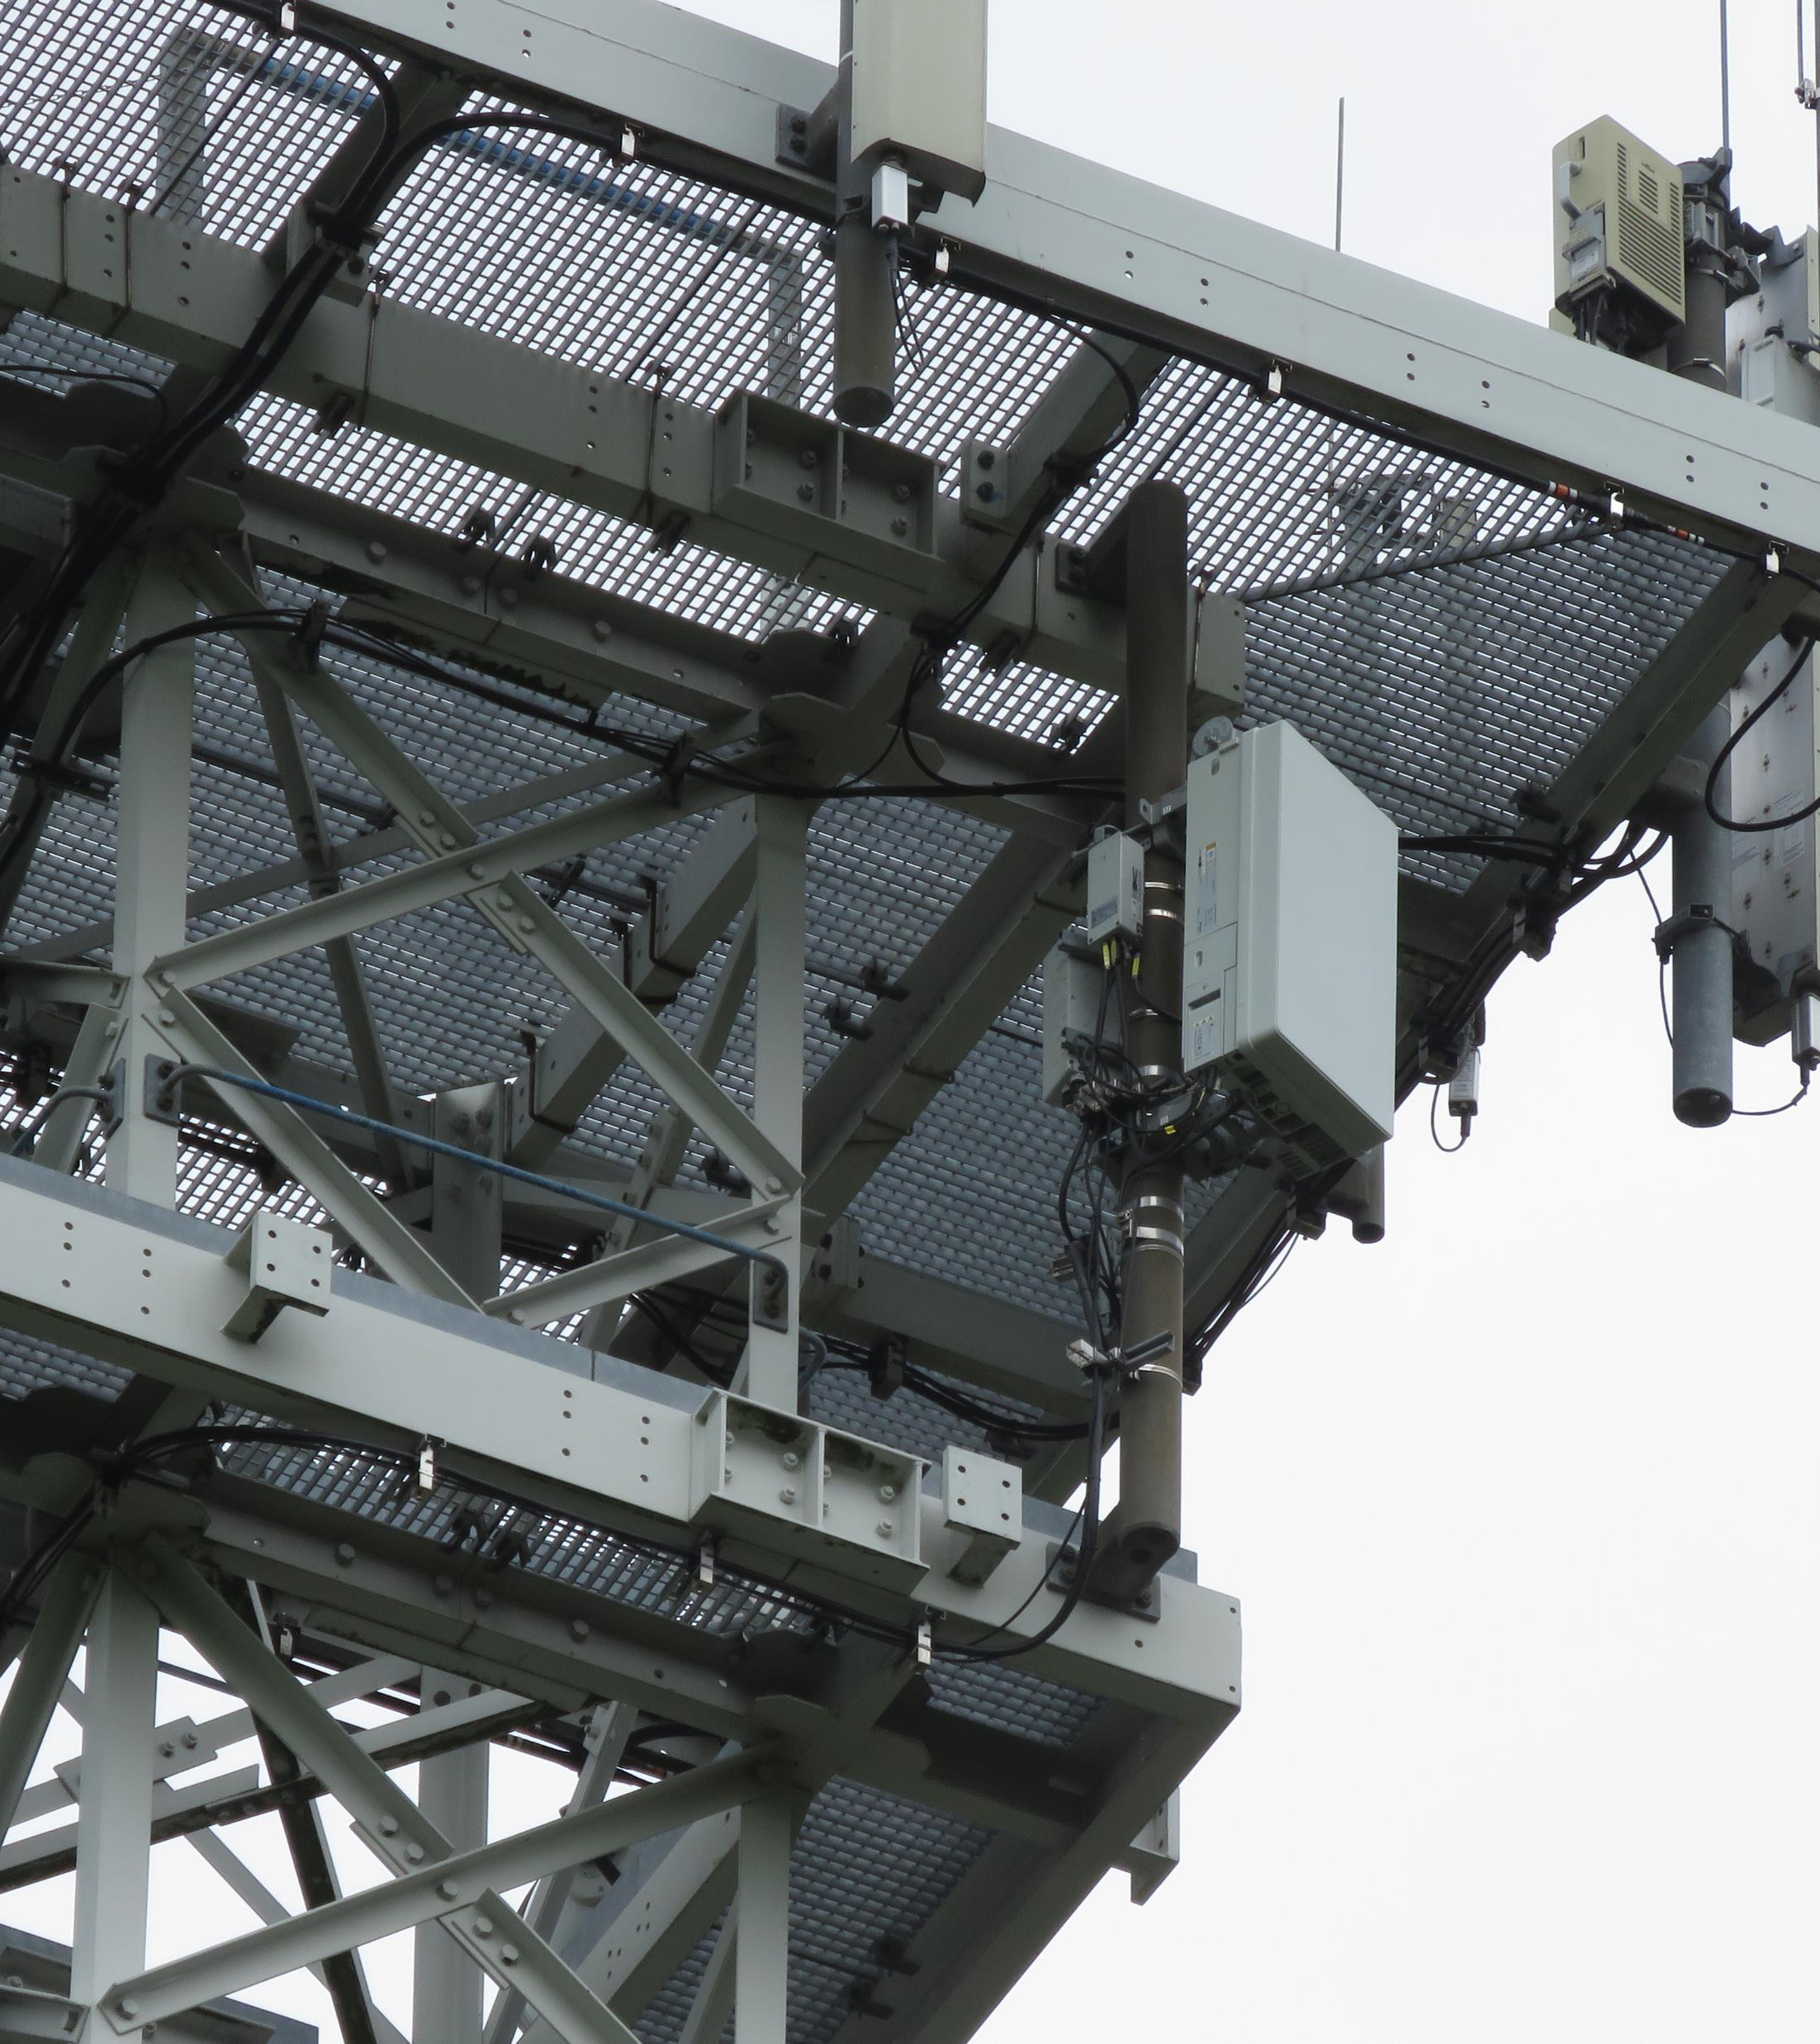
Industrial use cases of 5G
SEMINAR

Slide 3


Opening words
Who we are and what is project 5G HUB Vaasa?
The project is a collaboration between three universities:
The European Regional Development Fund (ERDF) and Regional Council of Ostrobothnia are co-financing the 5G HUB Vaasa project.

Slide 4
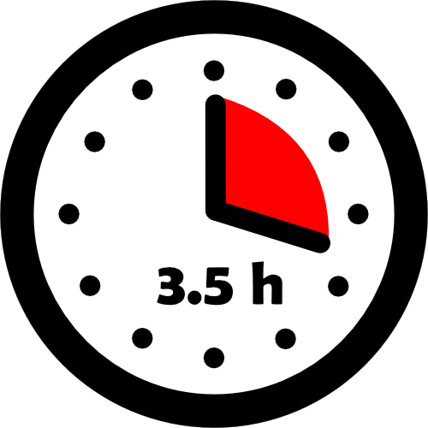
Program rundown
12.00 | Opening of the seminar
12.10 | 5G and beyond | Nokia, 6G flagship theme leader Olli Liinamaa
12.40 | Private 5G networks: The cornerstone to Business Adaptability in Industry 4.0 | Edzcom, CTO Kari Lehtinen
13.00 | Open source is enabling innovation in 5G and beyond | OpenAirInterface Software Alliance, Director of operations Irfan Ghauri
13.20 | Private 5G infrastructure | Firecell
13.40 | 4G/5G from the lab to the field | Amarisoft, Vice President Marouan Benabdellah-Chaouni
14.00 | Coffee break
14.20 | Nokia veturi program and Industrial metaverse | Nokia, Program Director Jarkko Pellikka
14.40 | Site-to-site communications for messages used in Wide Area Protection | ABB, Program Manager, Petri Hovila
14:55 | Industrial 5G and connectivity use cases | Siemens, Portfolio Consulting Professional, Teemu Kumpulainen
15.10 | 5G HUB Vaasa laboratory and services
15.30 | Closing of the seminar
 | Laboratory visit & Buffet

Slide 5

Presentations

Slide 6
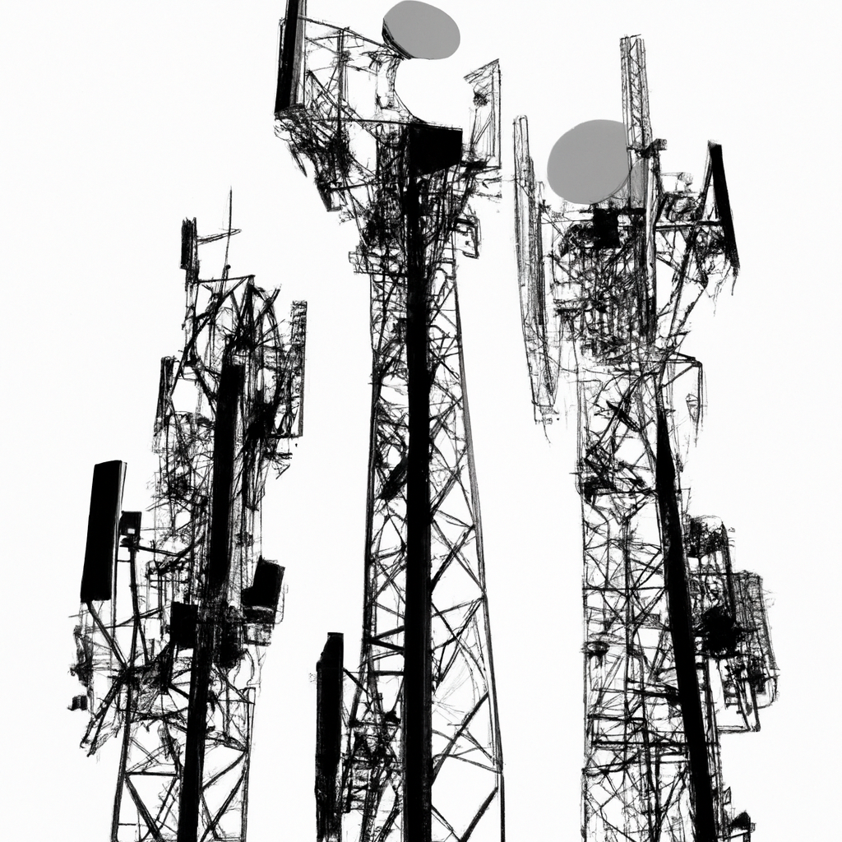
COFFEE BREAK
UPCOMING
14.20 | Nokia veturi program and Industrial metaverse
14.40 | Site-to-site communications for messages used in Wide Area Protection
14:55 | Industrial 5G and connectivity use cases
15.10 | 5G HUB Vaasa laboratory and services
15.30 | Closing of the seminar Laboratory visit & Buffet

Slide 7

Presentations continue

Slide 8
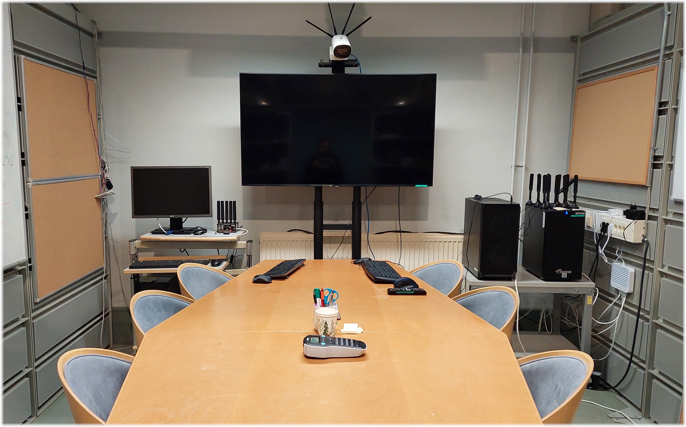
5G HUB Vaasa 5G test laboratory

Slide 9
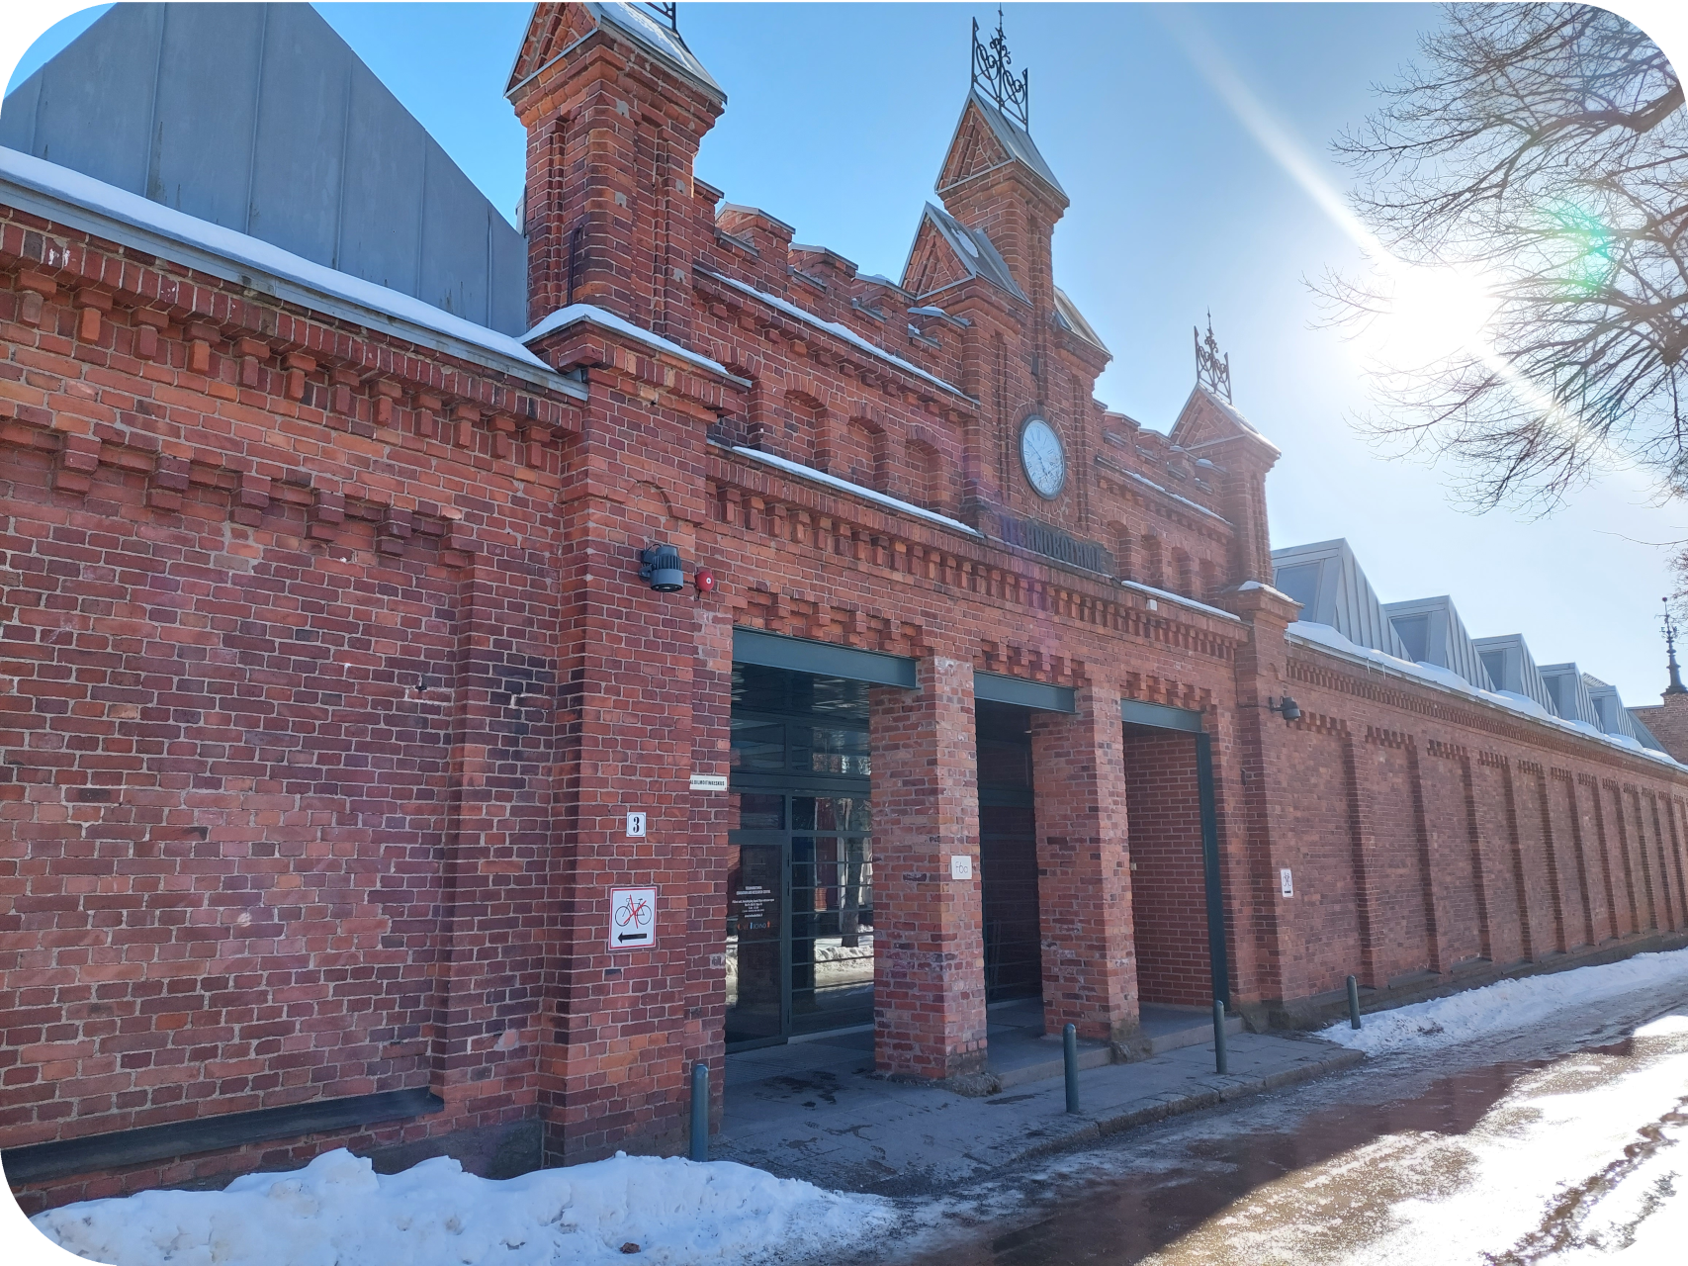
5G test Laboratory
Located in Technobothnia research laboratory in Vaasa
Provides services to regional companies
What does it provide:
An infrastructure to test applications in a real 5G network
Capacity to support R&D of 5G dependent applications in simulated and real environments
Partners and networks for applying funding for 5G related projects
An environment and knowledge base to support 5G related education
Skilful personnel from three collaborating partners

Slide 10
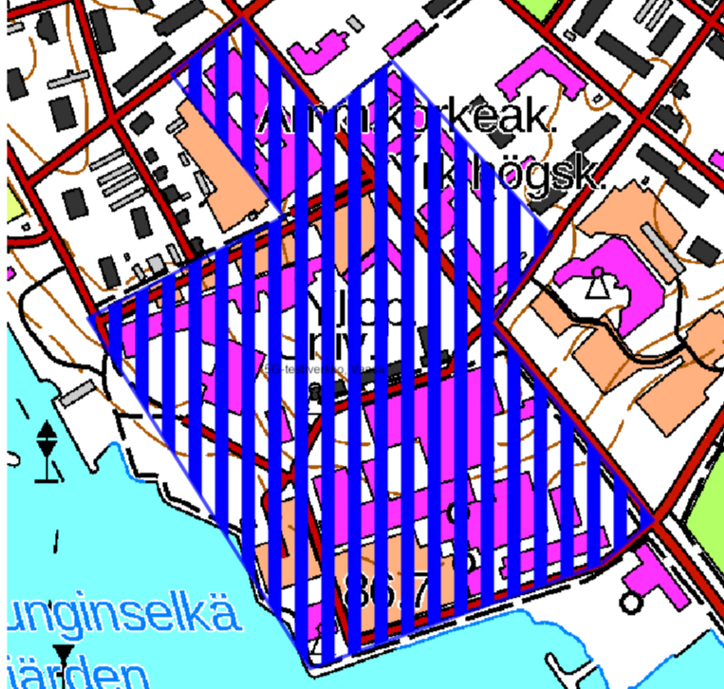
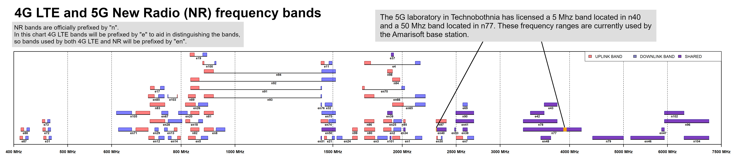
Frequency license
Frequency bands:
Vaasa 3900,000 MHz - 3950,000 MHz (n77 Band)
Vaasa 2300,000 MHz - 2305,000 MHz (n40 Band)

Slide 11
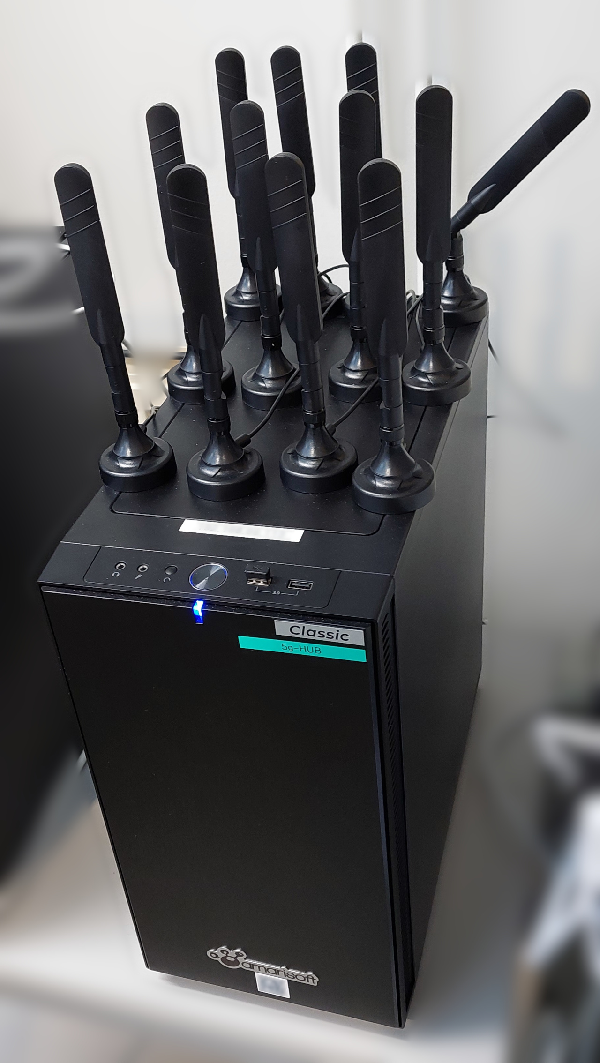
5G Base Station AMARI Callbox Classic
Specifications:
Support for 5G NSA/SA, LTE LTE-M and NB-IoT connections
4G/5G services, Standalone, and non-standalone
Possible to simulate FDD and TDD bands
Up to 1000 UEs
FR1 and FR2 (currently no license for FR2)
BW up to 100MHz
3 SDRs
10 meters Range
4x4 MIMO

Slide 12
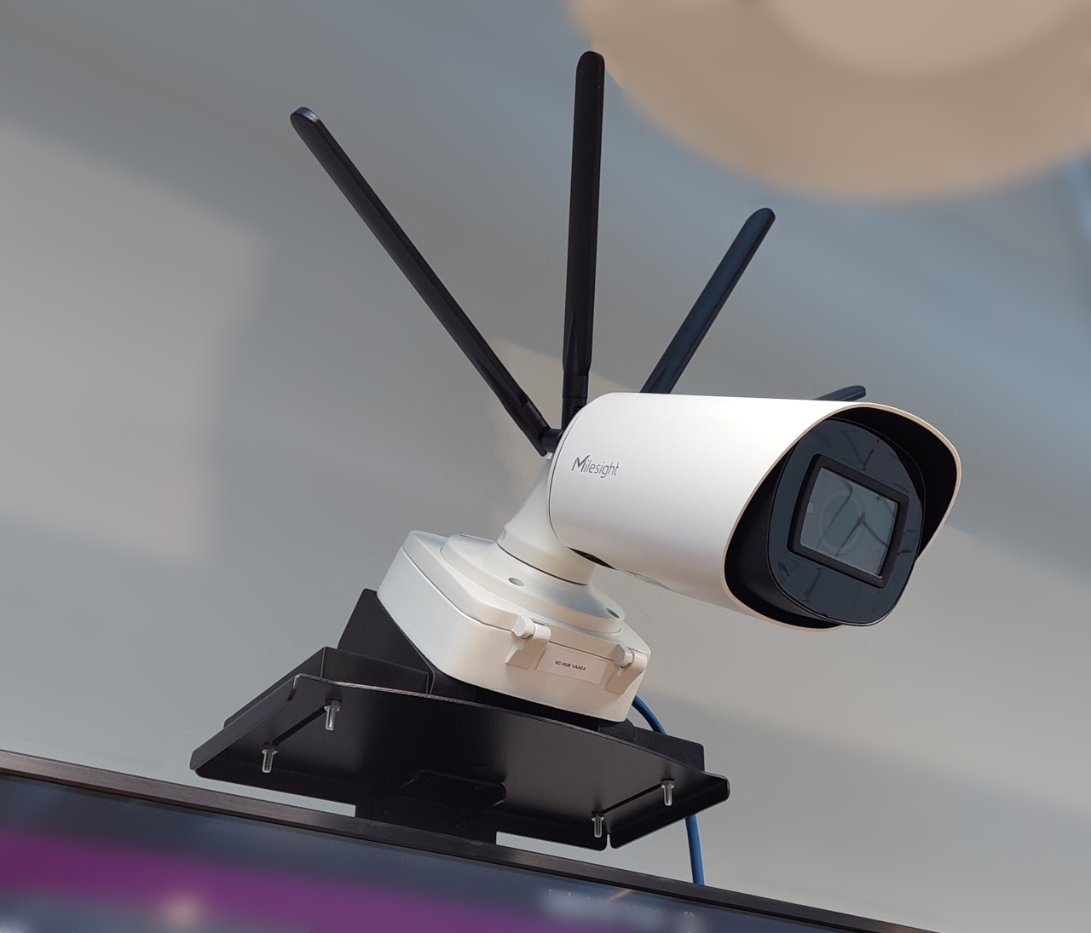
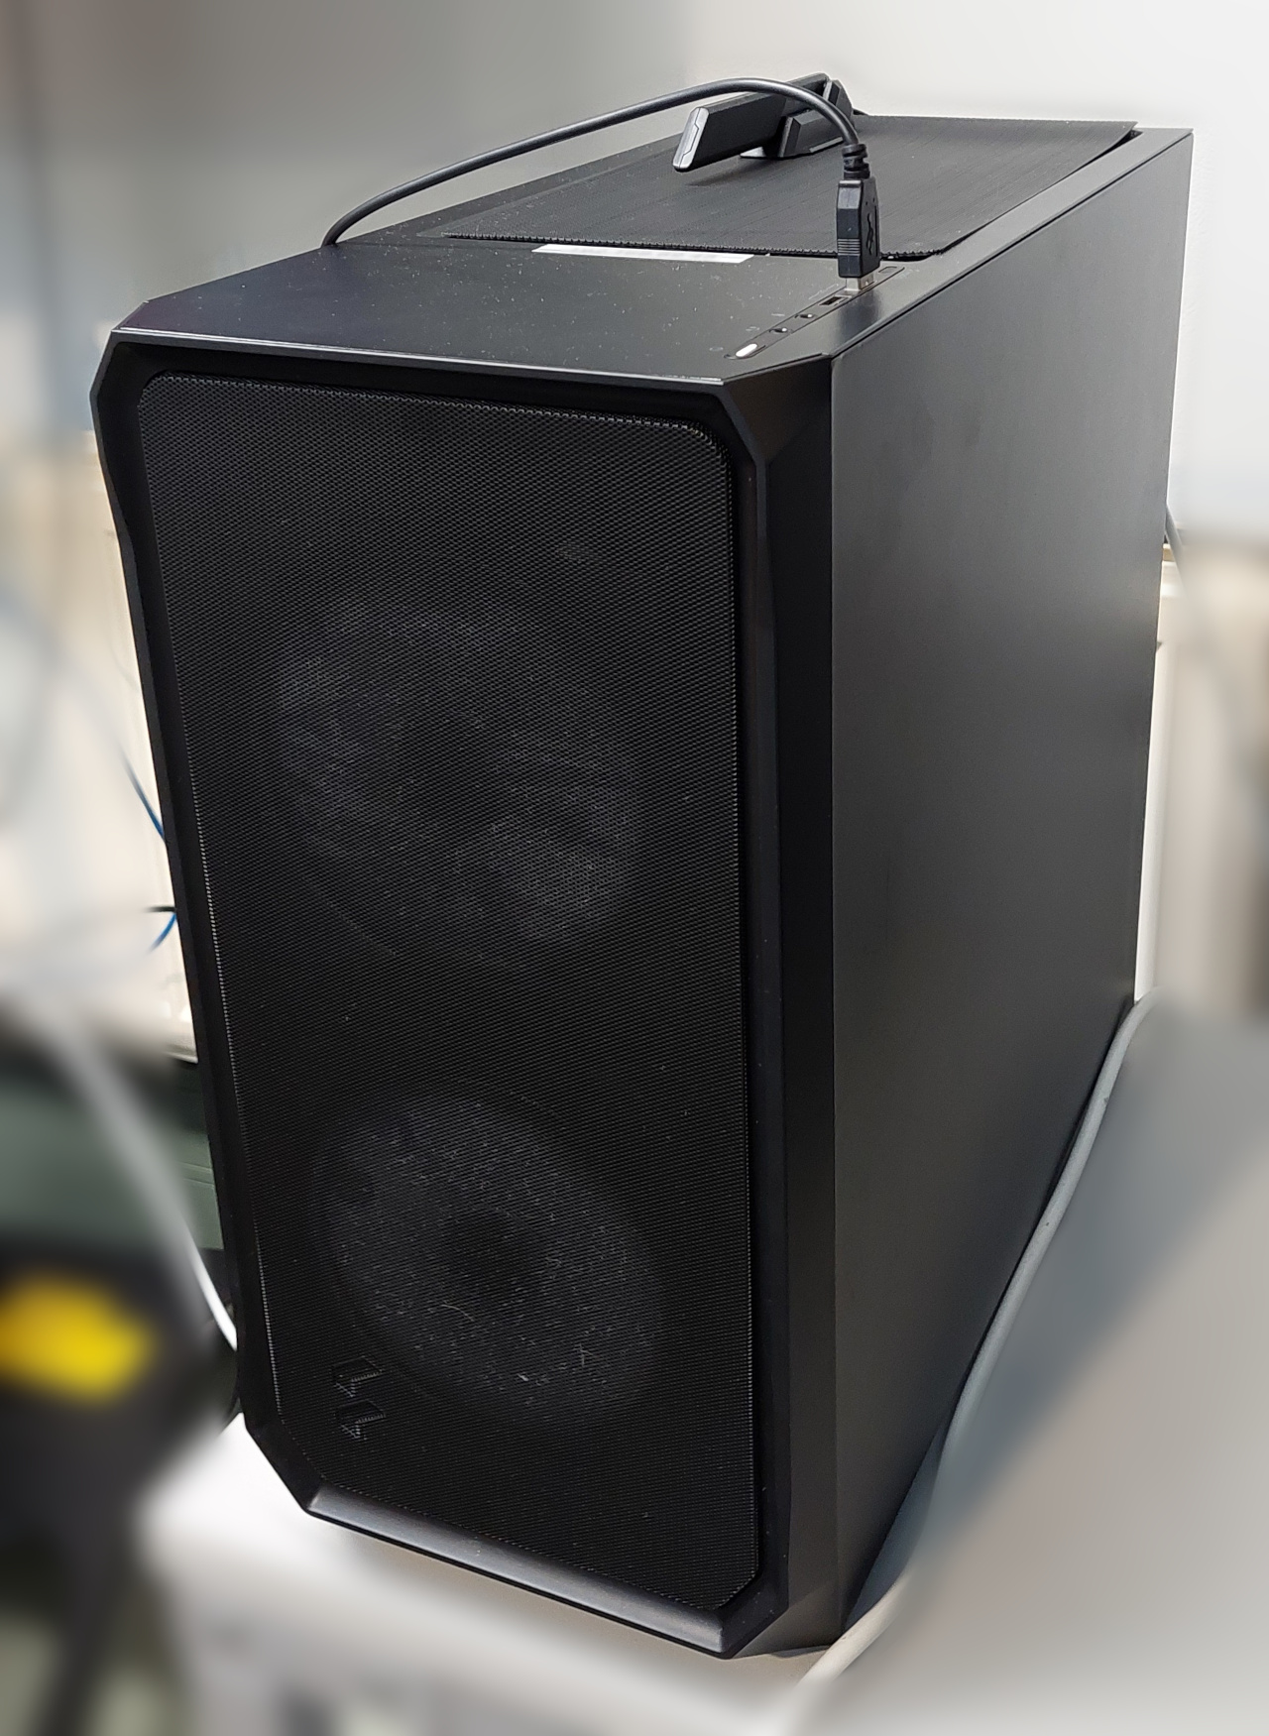
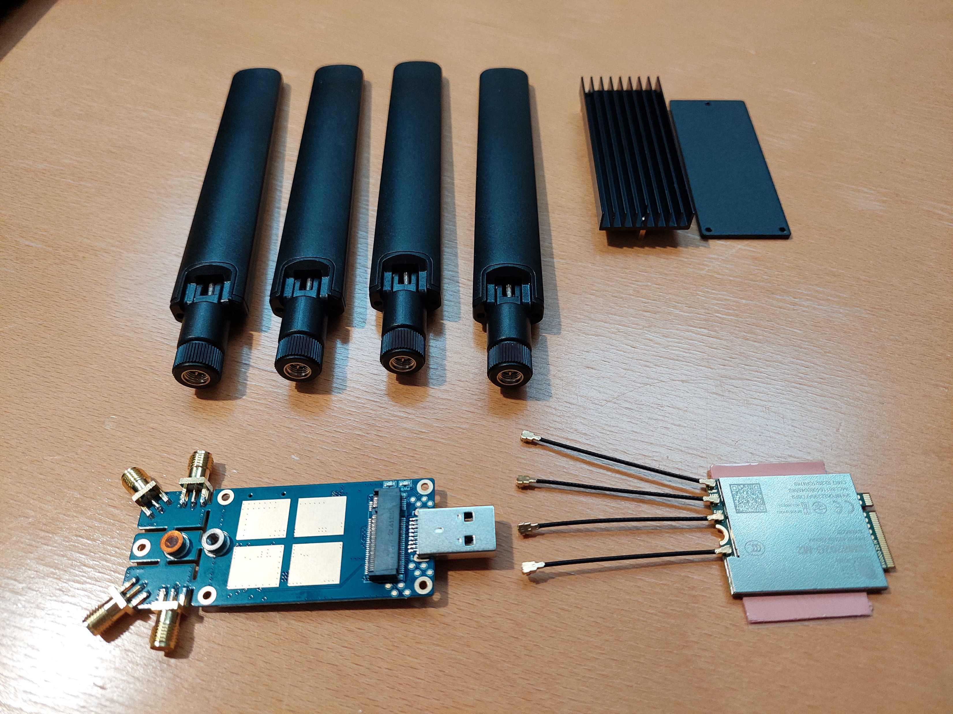
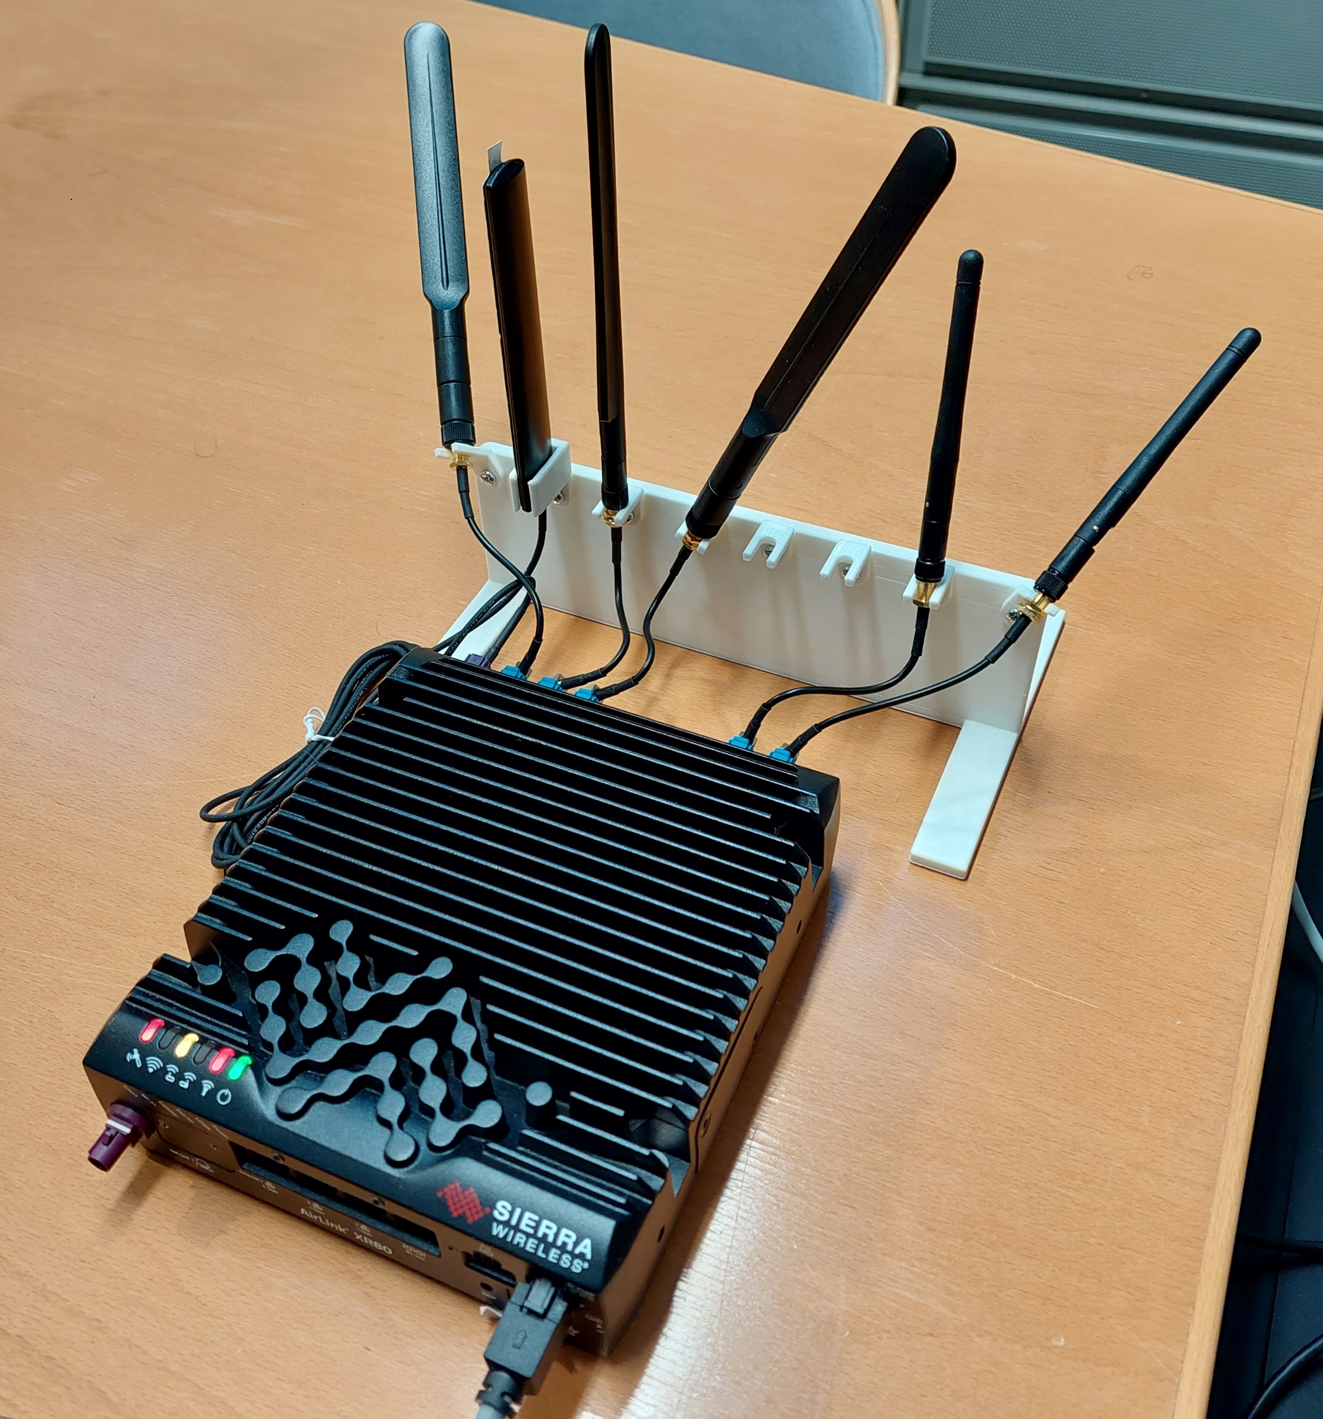
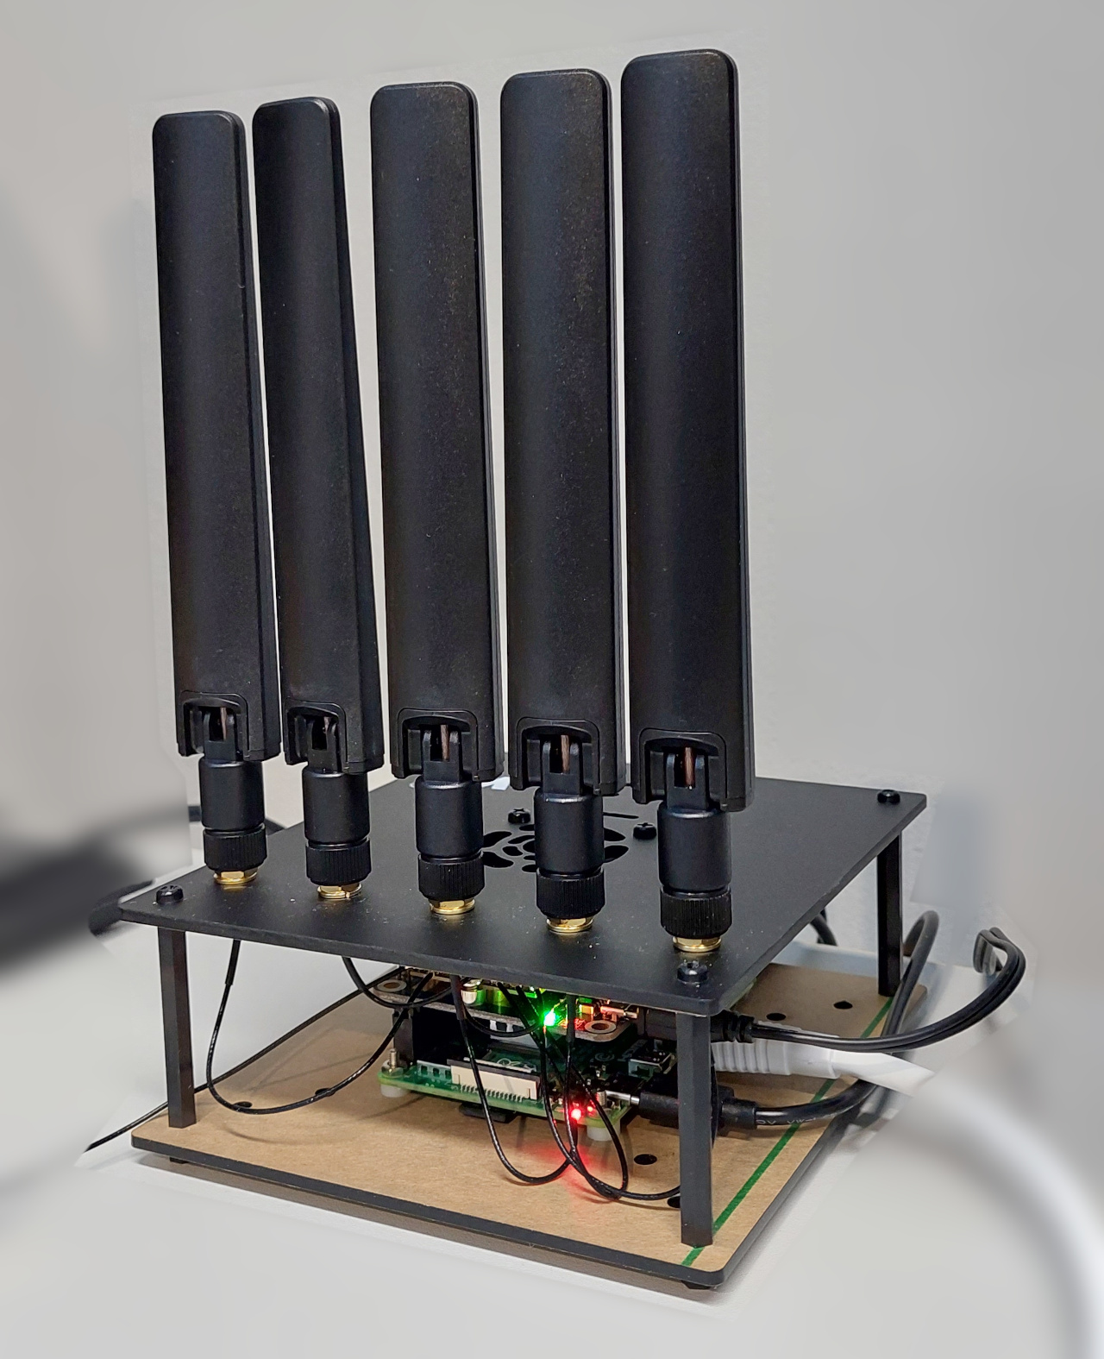
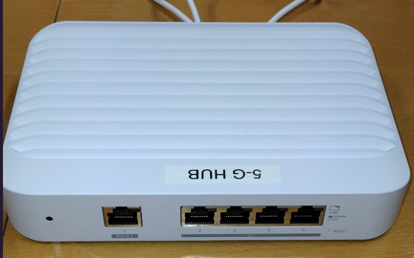
Other hardware
Edge server for CPU/GPU intensive tasks on the edge
Several models of 5G modules in the M.2 form factor
Raspberry PI microprocessors with 5G HATs
USB 5G dongles
5G security camera
Test SIM cards
5G router with edge capabilities

Slide 13
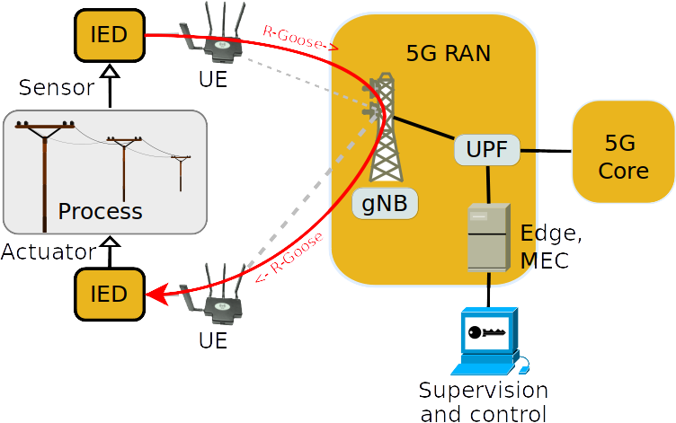
5G for smart grids
5G supports future, decentralized power system with intelligent monitoring, control, automation, and protection
One scenario tested in laboratory setup is sending R-GOOSE messages over 5G network. R-GOOSE is generated by an application running on Raspberry pi
Further tests are in progress

Slide 14
Results based on IETF RFC4656 Owping
One way latency of R-Goose over 5G messages is found to be approximately 25 ms with 5G standalone (SA) configuration in the laboratory.
Other one-way latency measurements are taken according to IETF RFC4656 using Owping command.
However, the latency results also depends upon the time synchronization between the U.Es.
Tests | NSA Config | SA Config | SA Config with low latency
One way Latency (avg.) | 17-25ms | 22-28ms | 9.6ms
Packet loss (100 packets) | 0.000% | 0.000% | 0.000%

Slide 15
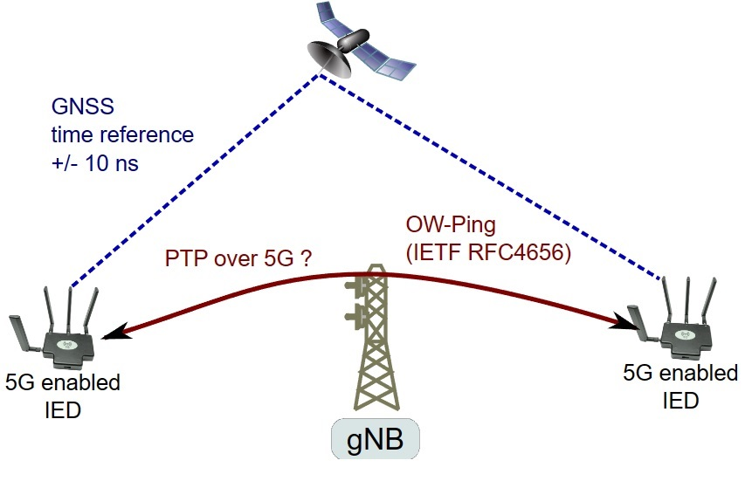
Time Synchronization over 5G
The U.E can be time synchronized over 5G network for accurate measurements.
Current measurement results are not very accurate, because the time reference of the nodes are not precise. We plan to fix that later using GNSS time reference.

Slide 16
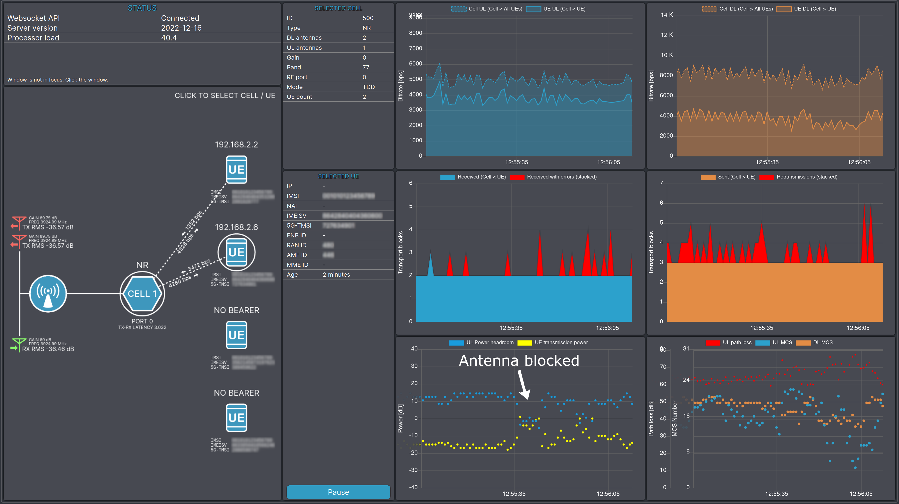
5G dashboard
Live metrics
Bandwidth
Signal quality
Network illustration
Recording and playback
Export of log data

Slide 17
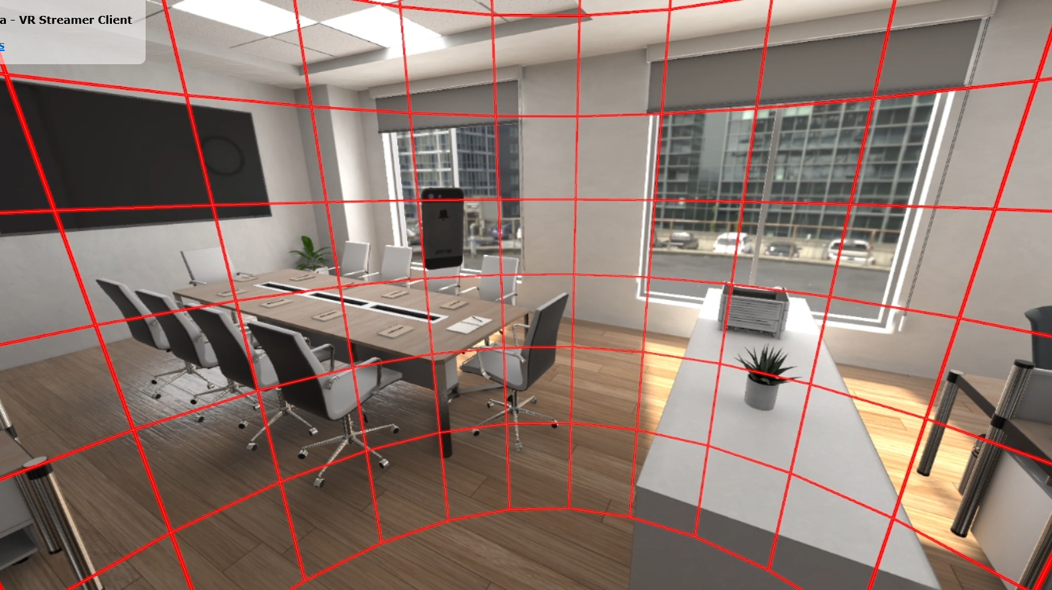
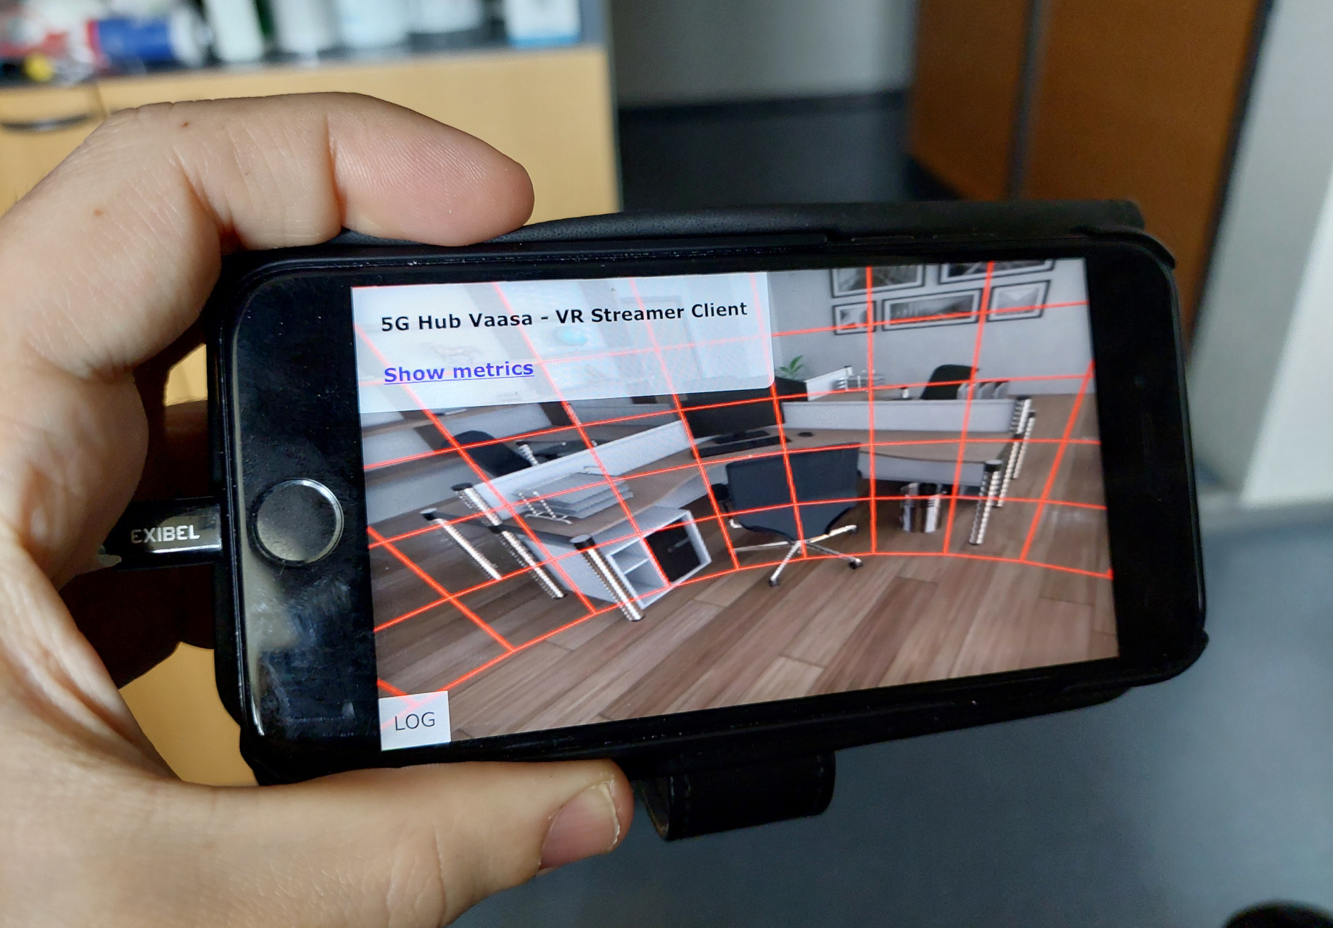
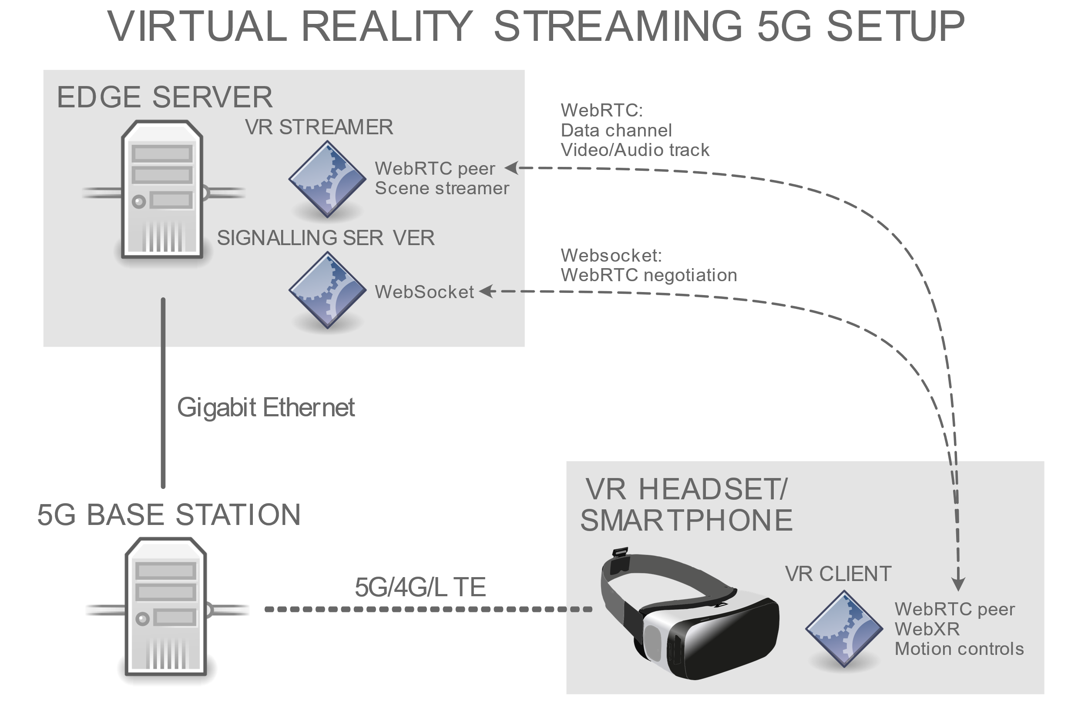
Virtual & Augmented reality streaming
Edge XR server
Low latency streaming over 5G using the WebRTC protocol and hardware accelerated H264 video compression/decompression
Streaming to mobile and virtual reality clients inside the web browser through the WebGL and WebXR interfaces
A dashboard provides real-time metrics such as connection bandwidth, stability, latency and WebRTC jitter buffer delay

Slide 18

Closing of the seminar

